Slide 1



Let's Do Something New
Style Secure Zone
Your Security Our Priority
Presented By:
👉 Prakash Mali (2203031050832)
👉 Khushal Shivade (2203031050625)
👉 Krishna Gutte (2203031050218)
👉 Sanyam Jain (2203031050853)
Project Guide: Prof. Shubham Upadhyay
#TheBoys

Slide 2
Abstract of project :
Virtual Changing room that allows users to try on clothes Virtually
Machine Learning for image processing, augmented reality (AR) for real-time visualization, and possibly 3D modelling for garment representation
better visualize fit and style, it aims to decrease the rate of returns​
Aligns with the growing trend of digital shopping and the use of AR in retail.
#TheBoys

Slide 3

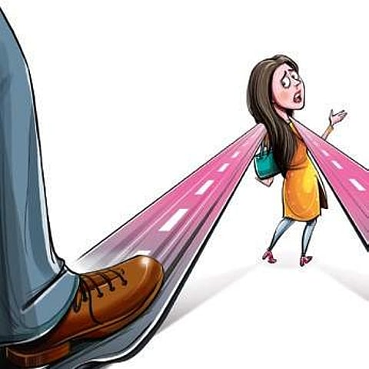
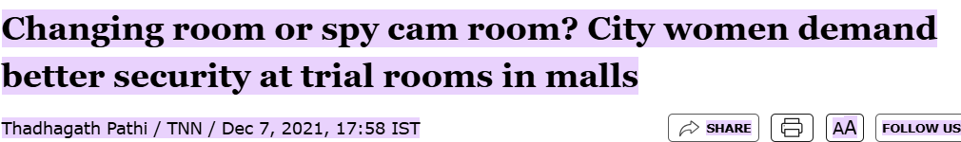
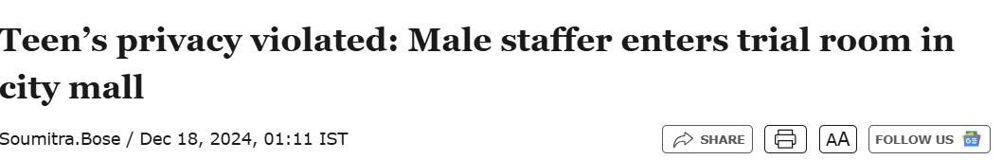
Motivation for project
Security of Women and men also
Ex. In Mumbai, one of Shop owner’s Employer does Cheat in the changing room
He attaches the Camera and makes MMS and Upload on the Internet
Also reduce Changing room lines of Customers
Example: -
#TheBoys

Slide 4


Methodology Use in Project
1. Data Collection: Gather diverse datasets of clothing images, body scans, and user profiles.
2. Image Processing: Machine learning algorithms analyze and segment clothing images for accurate visual representation.
3. 3D Modeling: Create 3D digital garments that mimic real fabric behavior and fit.
4. AR Integration: Develop AR application to overlay clothing on a user's real-time image via camera.
5. User Feedback: Incorporate user input to refine fit and style recommendations.
6. Deployment: Launch the app for users to virtually try on clothes, thereby reducing return rates.
#TheBoys

Slide 5

Flow of project Flow of Execution
Final Customer can See in Front Screen
Customer Choose Cloths
Arrange Changing Desk
Fit and manage Selected Cloth
Enter Cloth Code
Body Recognize
Cloths Size Recognition
#TheBoys

Slide 6

Innovative Research Module in project
Security of Woman
Maintenance of Room
Check Virtually Analyze Cloth Size and
Fitness of Clothes
Also add an E-commerce Website to Check
Reduces Retuning Policies
#TheBoys

Slide 7
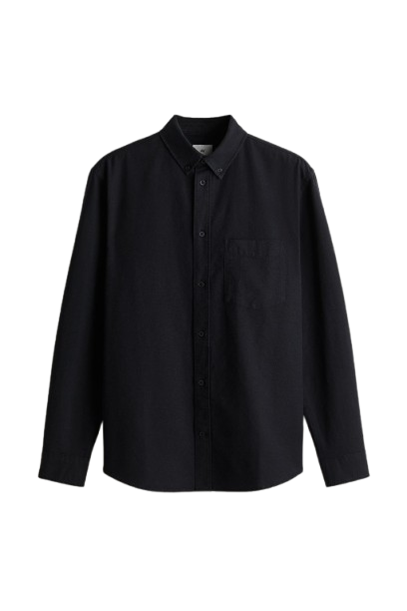

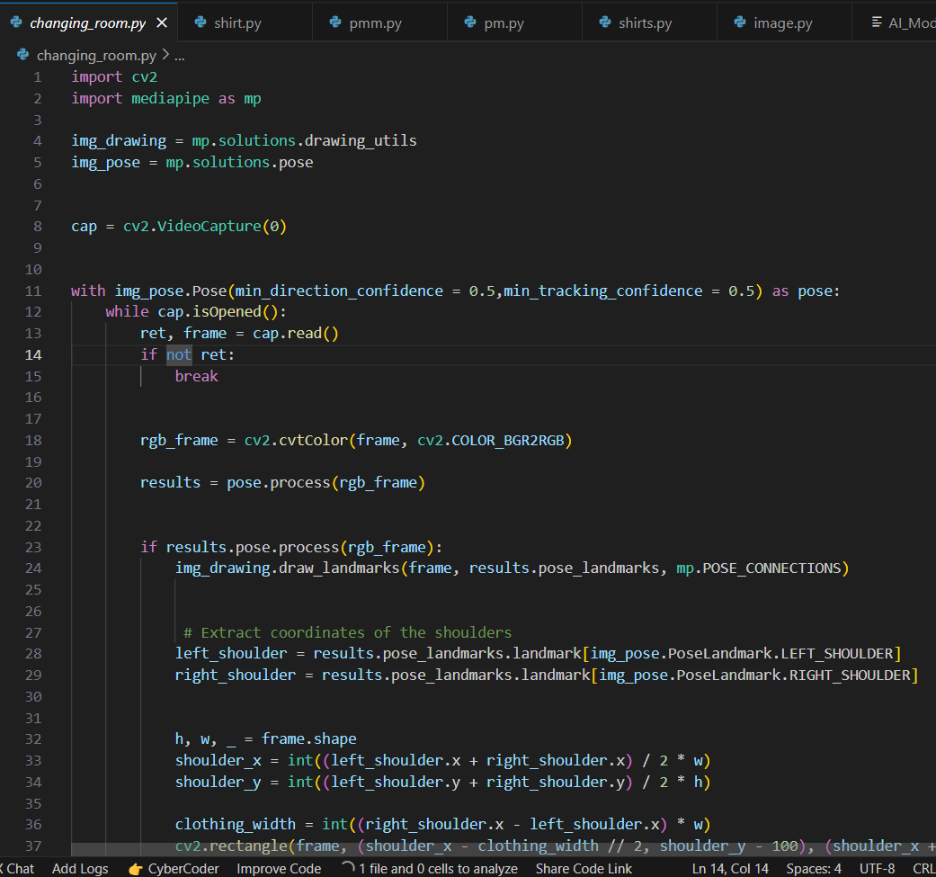
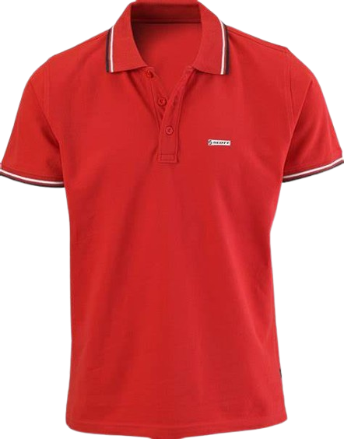
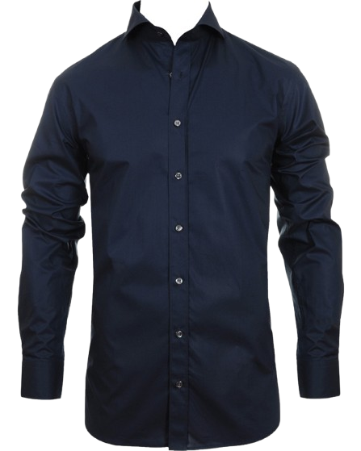
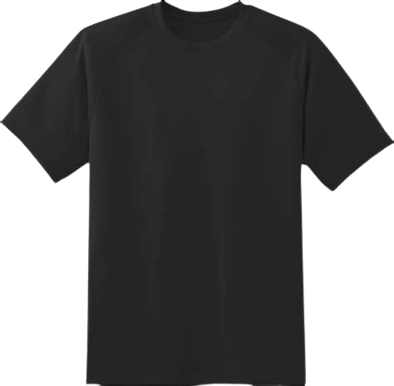
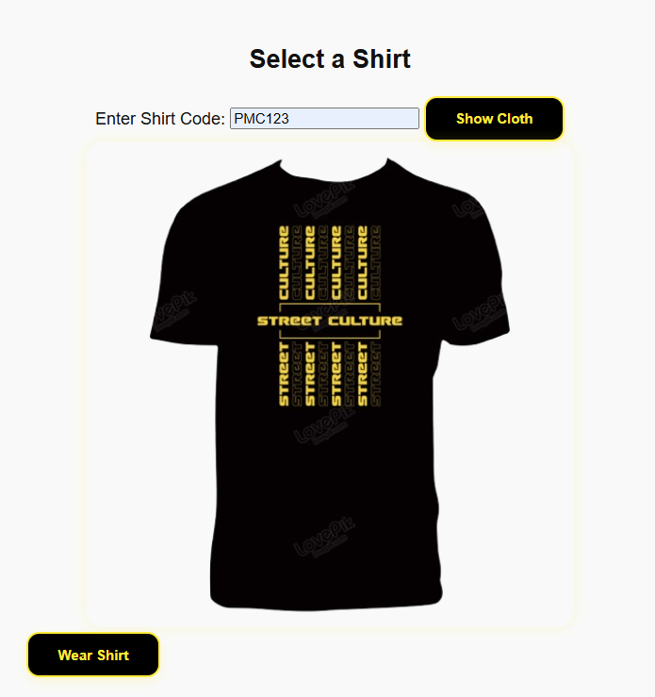
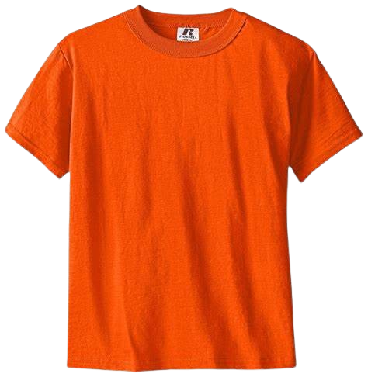
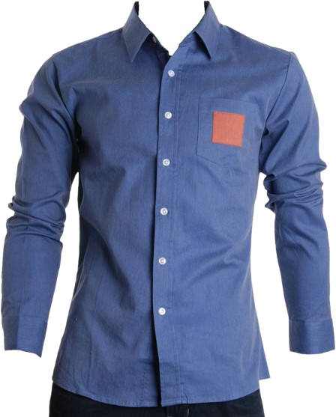
Screenshot of Project working model
#TheBoys

Slide 8
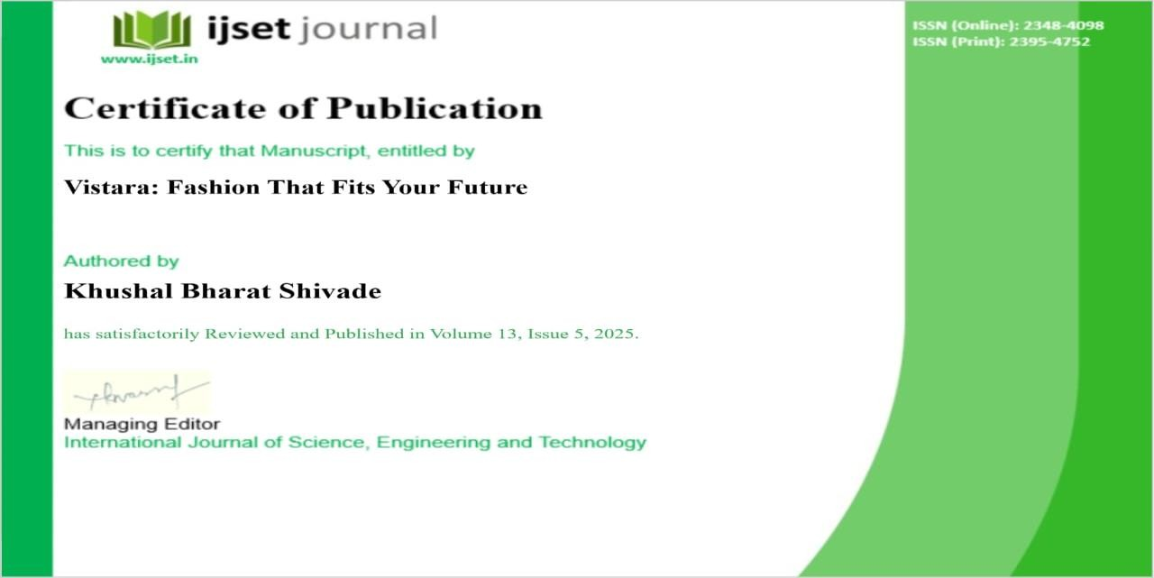
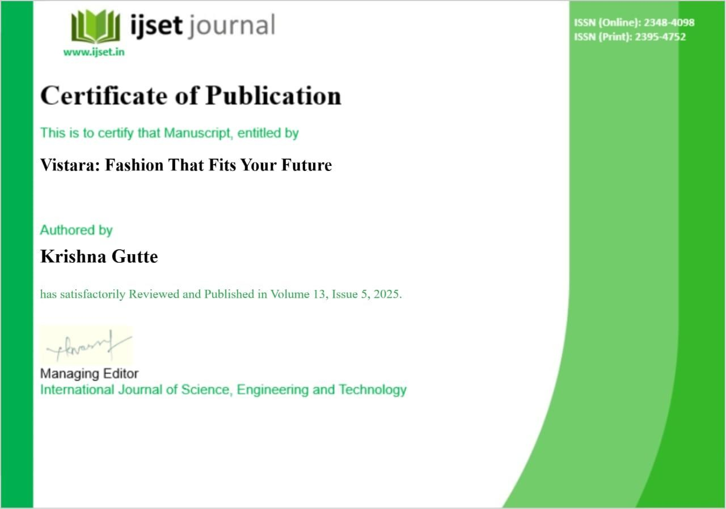



Slide 9
Research Paper For Project
Sr. No. | Title of Paper | Year | Author | Abstract | Methodology | Future scope
1.1 | Virtual Trial Room with Computer Vision and Machine Learning | 17 Dec 2024 | V Werdayani & I Widiaty | AI-driven Virtual Trial Room uses 3D models for better fitting wearables, boosting online shopping confidence. | Key methodologies include 3D reconstruction, object detection, ML, UX testing, and agile development. | Future scope includes AI personalization, AR, IoT integration, and enhanced user experiences.
1.2 | ML-Based Retail Innovations: Virtual Fitting, Scanning and Recommendations | 7 April 2023 | Malhar Bangdiwala, Sakshi Mahadik, Yashvi Mehta, Abhijeet Salunke | The paper explores ML in retail, focusing on virtual trials, self-checkout, and personalized recommendations. | The paper reviews literature on ML in retail, focusing on systems and customer feedback analysis. | Future ML in retail aims for better personalization, AR trials, efficient checkout, and sustainability.

Slide 10
Sr. No. | Title of Paper | Year | Author | Abstract | Methodology | Future scope
1.3 | Virtual Trial Room Using AR and AI | March 2023 | Omkar S. Jadhav, Kiran S. Ambatkar, Prathamesh D. Kulkarni, Anuja S. Modhave, Mrs. Supriya S. Gadekar | The app uses AI and AR for virtual clothing trials with realistic movement and lighting. | The methodology captures user images, maps bodies, and overlays realistic 3D clothing. | Future scope includes AI recommendations, improved simulations, and social sharing features.
1.4 | Quantifying and attenuating pathologic tremor in virtual reality | 18 Aug 2022 | Brian A. Cohn , Dilan D. Shah , Ali Marjaninejad, Martin Shapiro,etc | VR experience measures tremors with smooth tracking in a fun task. | A VR balloon-popping task measures tremors using smooth tracking. | Future VR research may enhance therapies with biofeedback and sensors.
1.5 | Combining Machine Learning and RAG Models | 16 Feb 2024 | Jaswinder Singh | The paper explores ML and RAG models for improved data retrieval. | The methodology involves data preprocessing, vectorization, and model optimization. | Future scope includes enhancing retrieval accuracy and user personalization.

Slide 11
Sr. No. | Title of Paper | Year | Author | Abstract | Methodology | Future scope
2.1 | Virtual fitting room technology in fashion design | 2021 | D Werdayani & I Widiaty | The paper explores virtual fitting rooms transforming fashion design. | Literature review highlights VFR technology’s benefits and challenges. | Virtual fitting rooms offer AR interaction for trying on clothes.
2.2 | Virtual Fitting Room using Webcam | 2015 | Chinmay Barde, Soham Nadkarni, Nikhil Joshi and Saurabh Joshi | The VFR streamlines fashion coordination with real-time garment visualization. | The system uses image segmentation for realistic AR clothing overlays. | The 2D VFR method improves garment visualization and future standardization.
2.3 | A Cost-Efficient Approach for Creating Virtual Fitting Room using Generative Adversarial Networks (GANs) | 2024 | Kirolos Attallah, Girgis Zaky, Nourhan Abdelrhim, Kyrillos Botros, Amjad Dife, Nermin Negied | The VFR app enhances virtual try-ons using GANs for realism. | The study's three phases ensure efficient image transformation. | Future work includes expanding datasets and optimizing model performance.

Slide 12
Sr. No. | Title of Paper | Year | Author | Abstract | Methodology | Future scope
2.4 | Smart Fitting Room: A One-stop Framework for Matching-aware Virtual Try-on | 2024 | Mingzhe Yu, Yunshan Ma, Lei Wu, Kai Cheng, Xue Li, Lei Meng, Tat-Seng Chua | HMaVTON offers personalized virtual try-ons, enhancing item compatibility. | Smart Fitting Room enhances try-ons with GANs, ensuring user satisfaction. | Future work aims to expand HMaVTON with more fashion items and styles.
2.5 | Virtual Trail Room: A Comprehensive Literature Survey | 2025 | Sheeban E Tamanna, Vikhyath K S, Chandana N, Dileep K, Sony Preethi Dsouza | The system enables real-time clothing try-ons via standard webcams. | The system uses GANs for realistic try-ons through image processing. | Virtual Trial Room boosts e-commerce by enhancing customer satisfaction.
#TheBoys

Slide 13
Sr. No. | Title of Paper | Year | Author | Abstract | Methodology | Future scope
3.1 | Immersive Color Perception: How Virtual Environments Influence Emotions | 2023 | J. Smith et al. | Color schemes in VR influence users' emotions and immersion levels. | The study used mixed methods to assess VR color effects on emotion. | Future research may focus on cross-cultural color perception in VR.
3.2 | Smart Virtual Dressing Room: Enhancing Fashion Retail with Kinect Technology | 2022 | L. Chen et al. | Kinect boosts virtual dressing rooms, enhancing engagement and lowering returns. | Prototype tests with shoppers assessed Kinect's impact on satisfaction and intent. | Future development includes mobile expansion and AI for size adjustments.
3.3 | Interactive Virtual Mirror: Merging Augmented Reality with Human Avatars | 2024 | M. Gupta et al. | AR virtual mirror enhances personalization with realistic avatars in retail. | Laboratory tests with AR involved eye-tracking and participant feedback. | Future research will focus on multi-user interactions and telepresence.

Slide 14
Sr. No. | Title of Paper | Year | Author | Abstract | Methodology | Future scope
3.4 | Beyond Virtual Reality: The Next Leap in Immersive Experiences | 2025 | R. Patel et al. | The paper predicts a shift to fully immersive environments with mixed reality and haptics. | The methodology included literature review, expert interviews, and trend analysis. | The paper suggests developing prototypes that blend olfactory and tactile stimuli for deeper immersion.
3.5 | AI-Powered Virtual Fitting Room: Transforming the Shopping Experience | 2023 | K. Nguyen et al. | The AI-driven virtual fitting room enhances user satisfaction and decision-making online. | The research involved AI training, participant testing, and satisfaction analysis. | Future plans include social media integration and AR glasses for in-store use.
#TheBoys

Slide 15
Sr. No. | Title of Paper | Year | Author | Abstract | Methodology | Future scope
4.1 | Exploring Colour in Context Using Virtual Reality: Does a Room Change How You Feel? | 2020 | Ruby Lipson-Smith, Julie Bernhardt, Edoardo Zamuner, Leonid Churilov, Nick Busietta, Damian Morat | Study shows VR affects color perception and mood by setting. | The study used VR to assess mood and color preference in rooms. | Future research could explore color-mood effects in diverse environments.
4.2 | Virtual Dressing Room Application with Virtual Human Using Kinect Sensor in the Era of Industry 4.0/5.0 | 2015 | Muhammed Kotan, Cemil Öz | The system uses Kinect and VR for efficient virtual clothing try-ons. | Kinect SDK enables real-time tracking for interactive virtual try-ons. | Future work could enhance the system with AI and more garment options.
4.3 | Virtual Mirror with Virtual Human Using Kinect Sensor | 2014 | Muhammed Kotan, Cemil Öz | The system enhances online shopping with Kinect and VR for try-ons. | Kinect SDK and Unity enable interactive, user-friendly virtual try-ons. | Future improvements may include AI integration and more customization options.

Slide 16
Sr. No. | Title of Paper | Year | Author | Abstract | Methodology | Future scope
4.4 | A Step Change from Virtual Reality | 2009 | Alan Chalmers, David M. Howard, Christopher Moir | Real Virtuality enhances VR by engaging all senses for immersive experiences. | Real Virtuality uses the Virtual Cocoon for immersive multi-sensory experiences. | Future work may expand Real Virtuality applications in more industries and settings.
4.5 | Virtual Trial Room | 2014 | Sakshi Mahadik, Yashvi Mehta | The Virtual Trial Room enhances shopping by enabling virtual clothing try-ons. | The system employs Haar Classifier and OpenCV for realistic virtual try-ons. | Future developments could include AI enhancements and broader clothing options.
#TheBoys

Slide 17

Your Security Our Priority
Thank You
#TheBoys

